Slide 1
Flux Training
Alessio Bernardo
PhD Student @ Politecnico di Milano
Emanuele Falzone
PhD Student @ Politecnico di Milano

Slide 2
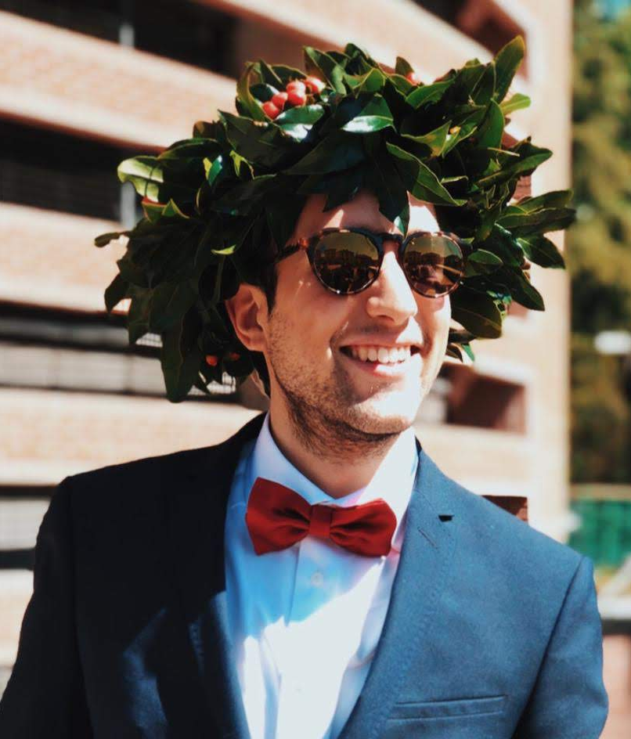
Alessio Bernardo, M.Sc.
Ph.D. Student | Politecnico di Milano
Expert in streaming data processing and time evolving analytic
Contributor of MOA
~3 years experience in innovation and research projects
Contact
alessio.bernardo@polimi.it
@alebernardo94
https://alessiobernardo.github.io/

Slide 3
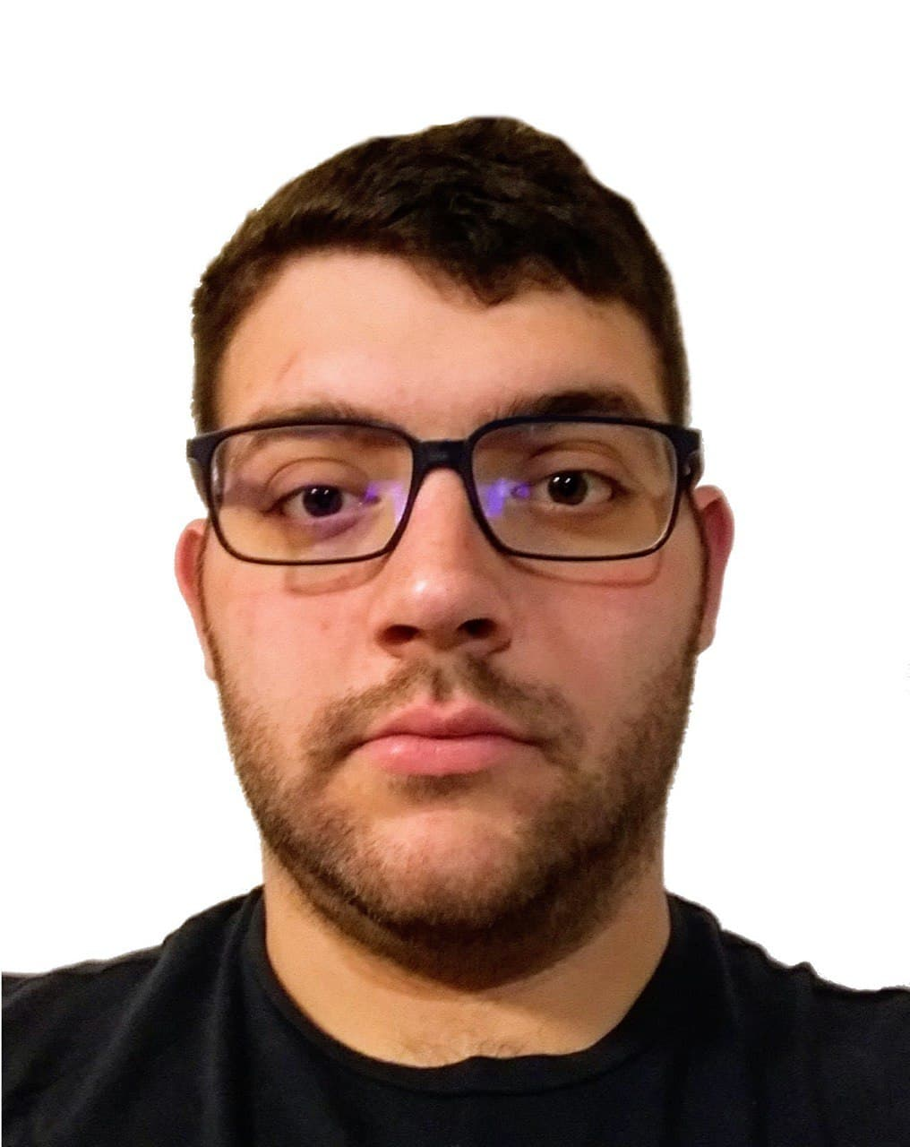
Emanuele Falzone, M.Sc.
Ph.D. Student | Politecnico di Milano
Expert in graph query languages
~3 years experience in innovation and research projects
Contact
emanuele.falzone@polimi.it

Slide 4
Flux Training
Alessio Bernardo
PhD Student @ Politecnico di Milano
Emanuele Falzone
PhD Student @ Politecnico di Milano

